Slide 1

CLUSTERING Global development
P456-6th group

Slide 2
P456 BATCH : GROUP 6TH
Akshata Shivarai
Chenna Kesava Reddy Bhomireddy Gari
Vyshnavi Nallagopu
Swati Sujit Deokar
Shinde Sanjana Bhaskar
Shanmukh A Chinmalli

Slide 3
INTRODUCTION :-
Objective:
To group countries based on development metrics using clustering techniques.
Analyze patterns and provide insights for global economic and development strategy.
Significance:
Helps policymakers understand country-level development clusters for targeted actions.

Slide 4
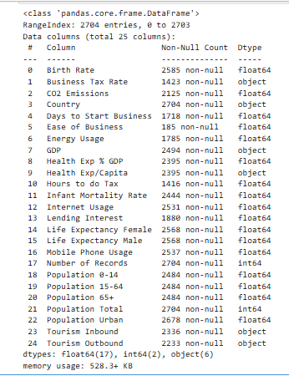
Exploratory Data Analysis
Info of variables present in the dataset -

Slide 5
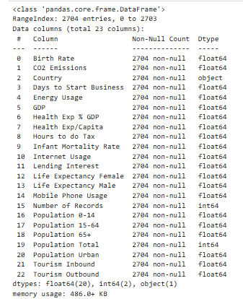
Identifying which variable has highest missing values-
If a variable contains highest missing values and if it doesn’t affect our analysis then we can drop those variables.
If the variable is crucial for our analysis then we will be replacing it with mean or mode.
For numerical variables- Mean
For categorical variables-Mode

Slide 6
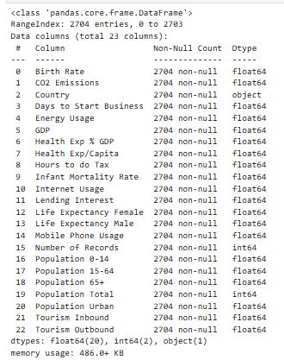
Type Conversion-
We want all columns to have numeric data types like float and integer. So we are converting object datatypes to required numeric datatypes.

Slide 7
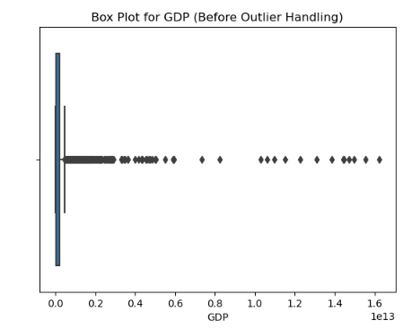
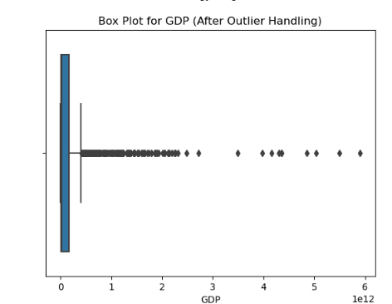
Identifying and handling outliers-
We have used Trimming method.
For instance, considering GDP variable,

Slide 8
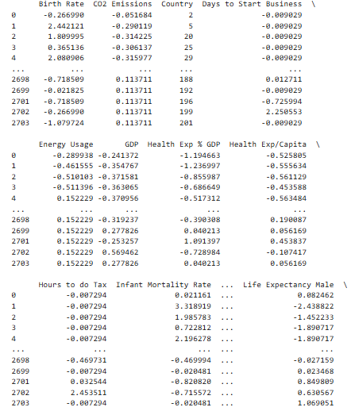
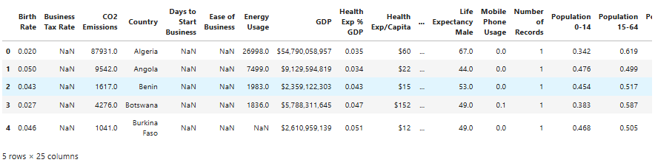
Data preprocessing-
For numerical columns- Applied Standard Scaler.
For categorical columns –Applied Label encoding.
Before data preprocessing,
After data preprocessing,

Slide 9
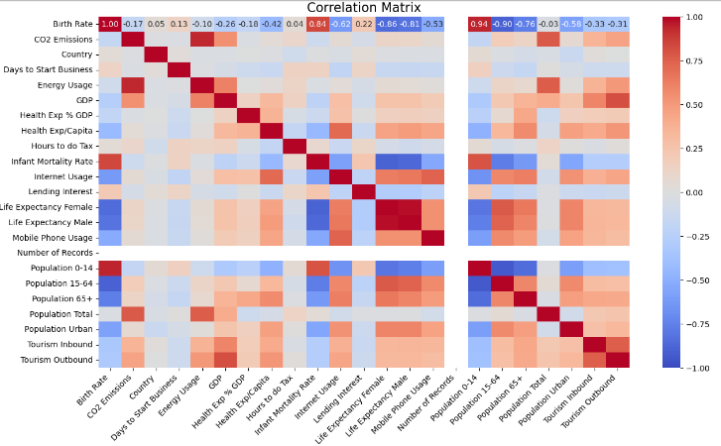
Correlation Matrix:

Slide 10
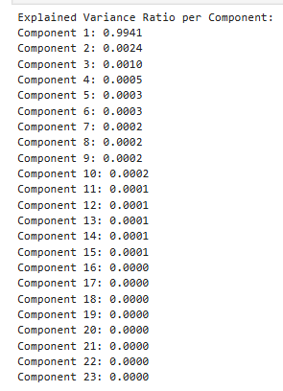
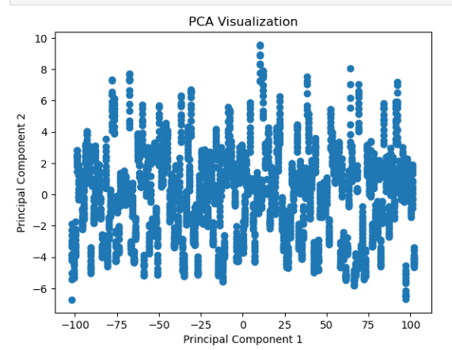
Checking whether any data loss after applying principle component Analysis-
Here we are checking data loss using Explained variance ratio per Component after applying PCA method.

Slide 11
Models verified-
Here we applied different types of clustering models like:
K- Medoids
Fuzzy C-Means
K-Means
Mean-Shift
Hierarchical Clustering (Single Linkage)
DBSCAN
Spectral Clustering.
Affinity Propagation
Gaussian Mixture Models
Hierarchical Clustering (f cluster)
Optics

Slide 12
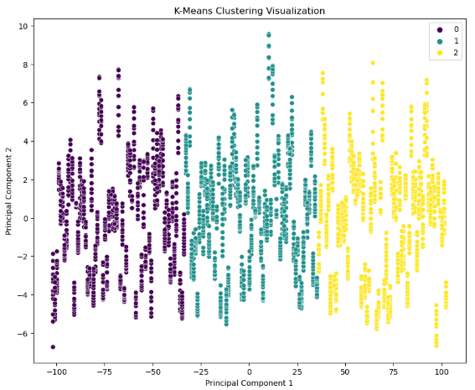
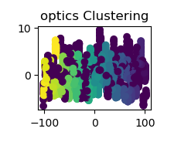
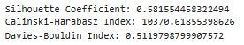
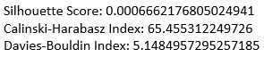
Comparatively, best model is k-means and model which has lower performance is optics

Slide 13
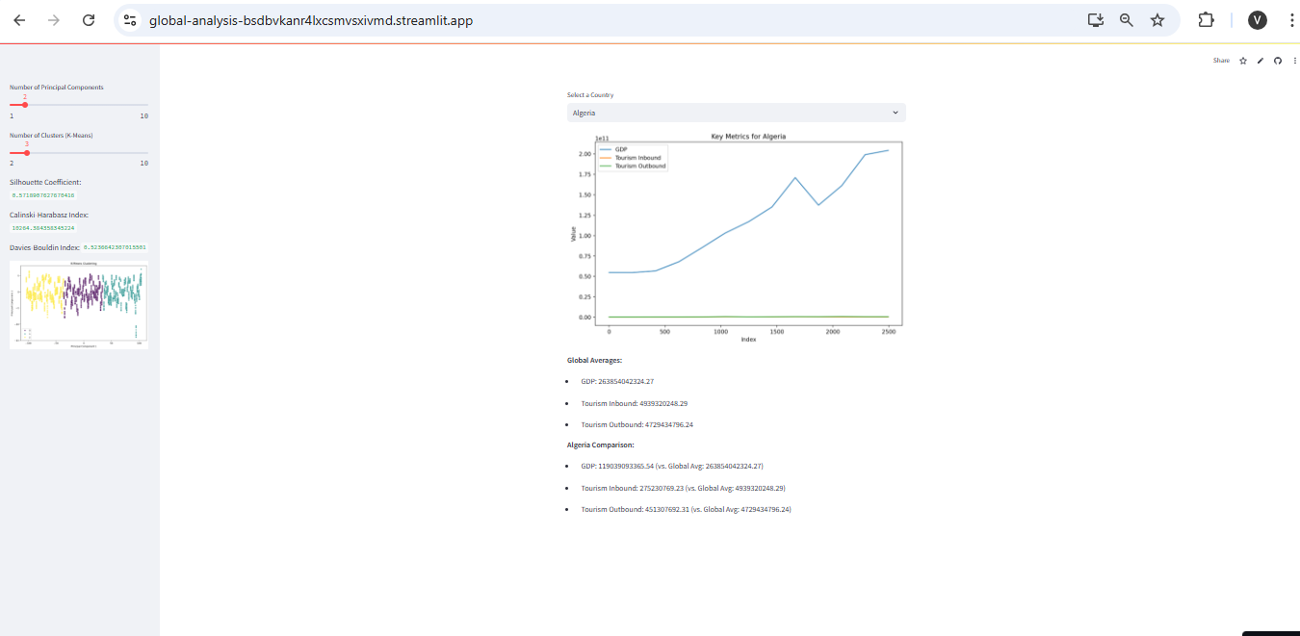
App Deployment with streamlit-
App URL: https://global-analysis-bsdbvkanr4lxcsmvsxivmd.streamlit.app/
APP UI:

Slide 14
Challenges faced-
Challenges:
Data Imbalance or Missing Values.
Selecting optimal number of clusters.
During deployment, faced module error
Solutions:
Imputation methods for missing data.
Use of metrics like the elbow method for determining clusters.
Overcame it by reinstalling module and removed all files which are with same name.

Slide 15
Conclusion-
Key Takeaways:
Clusters provide actionable insights into country-level development patterns.
The model and app enable intuitive exploration of global metrics.
Future Work:
Extend the analysis to include temporal trends.
Incorporate additional datasets for more robust insights.

